Slide 1

SyriaTel Customer Churn
By Jake Sherman

Slide 2
Overview
Business Problem
Predictions with Classification Models
Key Features Analysis
Recommendations
Next Steps

Slide 3
Business Problem
3,333 customers analyzed
Churn rate of 14.49%
Can we predict the customers that are going to churn so that we can deploy a plan to keep them before they leave?

Slide 4
Modeling Results
Random Forrest Classifier
Precision: 95%
Recall: 61%
Accuracy 94%
F1- Score 74%

Slide 5
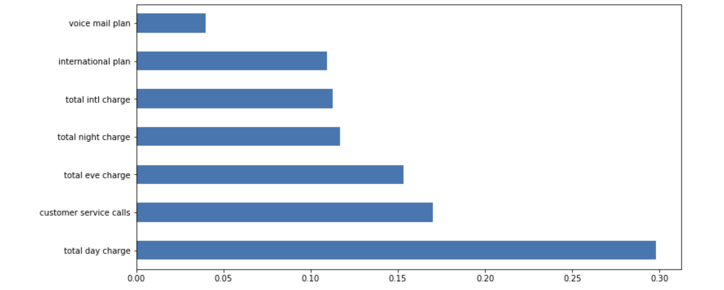
Key Features to Predict Churn
Charge, specifically total daytime charge (function of minutes)
Number of customer service calls

Slide 6
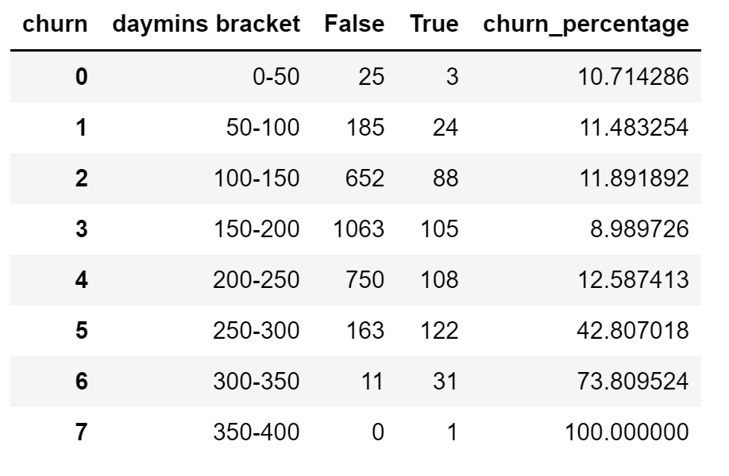
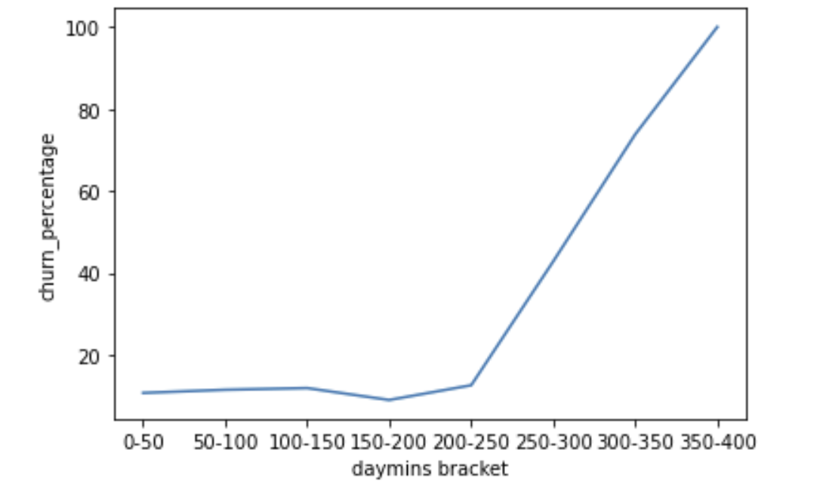
Key Feature Analysis
After 250 daytime minutes per month, churn rate increases dramatically
Day rate = .17c
Evening rate = .085c
Night = .045c

Slide 7
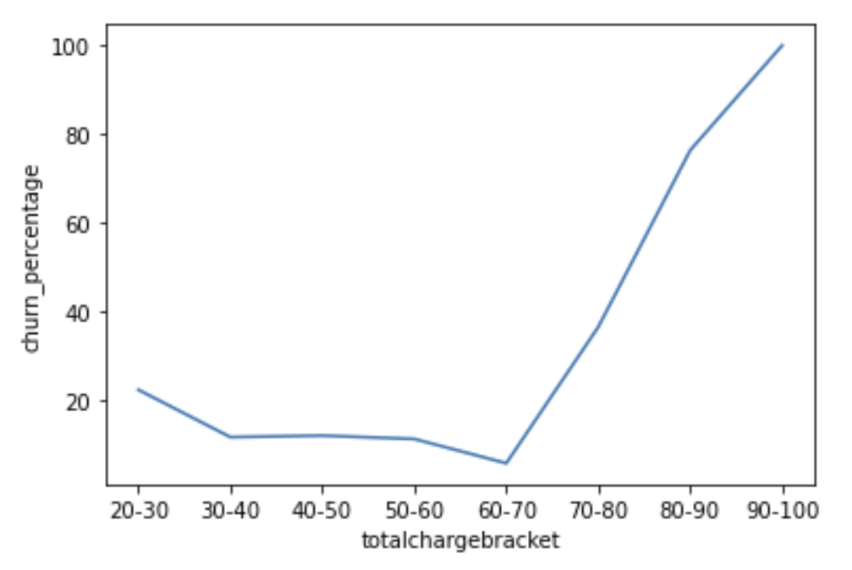
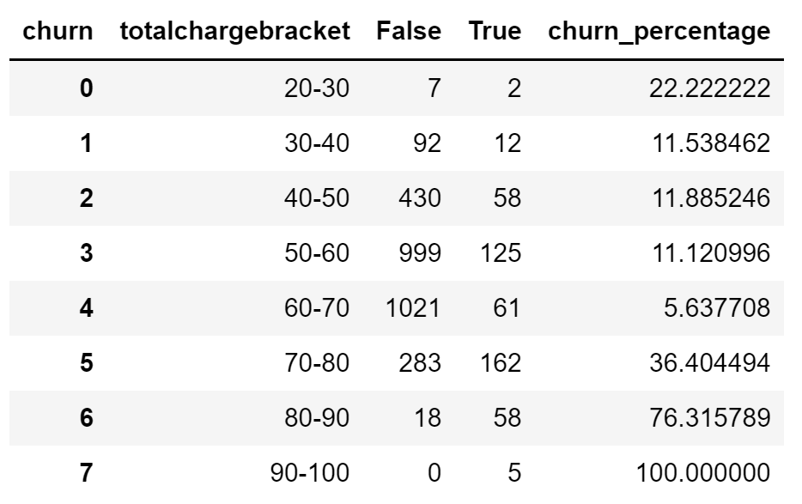
Key Feature Analysis
Total charge above $70 per month causes churn rate to spike dramatically.

Slide 8
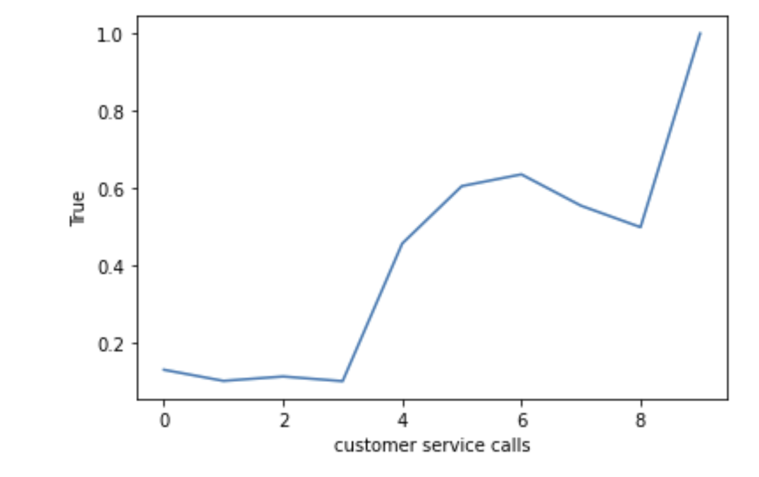
Key Feature Analysis
Above 3 customer service calls, churn rate spikes dramatically.
Customer Service Calls | Churn Rate
9 | 100.0%
6 | 63.6%
5 | 60.6%
7 | 55.5%
8 | 50.0%
4 | 45.8%
0 | 13.1%
2 | 11.5%
1 | 10.3%
3 | 10.2%

Slide 9
Recommendations
Reduce rates once a person has used 250 day minutes
Cap total monthly spend.
Once a person has called for support more than 3 times offer them a special promotion.
Create a pricing plan for people who plan to use a lot of minutes (above 250) such as unlimited minutes.

Slide 10
Next Steps
Analyze churn rate for each SyriaTel pricing plan against their competitors.
Opportunity to optimize pricing model.

Slide 11
Thank You
Github.com/jsherman918

